Slide 1

Major Project Final Viva–Voice Bachelor of Science(CCBD) V Semester – 2024
School of Computer Science and Applications

Slide 2
A PROJECT REPORT ON InstaNote
Submitted Final Viva-Voce Project report completion of BSc(CS) degree
Presented by:
Mr. Jayram Dhawal
Mr. Raj
SRN: R22DB017, R22DB031
Internal Guide: Dr.Devi A

Slide 3
Agenda
Existing System
Proposed System
Advantages of Proposed System
Methodology Used
Architecture Diagram
Class Diagram
Testing Strategy
Implementation
Result
Future Enhancement

Slide 4
Existing System
Local Storage: Files are stored on local devices, leading to limited accessibility and potential security risks.
Manual Sharing: File sharing often involves manual processes like email attachments or physical storage devices, which can be inefficient and error-prone.
Limited Scalability: The existing system may struggle to handle a large number of users and files, affecting performance and reliability.
Security Concerns: Files are susceptible to unauthorized access and data breaches due to lack of robust security measures.
No Centralized Management: Difficult to manage and track files, especially in collaborative environments.

Slide 5
Proposed System
AWS Integration: Utilizing AWS infrastructure for scalable, reliable, and cost-effective cloud services.
Amazon S3 Storage: Secure, durable, and scalable object storage for storing and retrieving any amount of data at any time.
Web-Based Interface: HTML, CSS, and JavaScript for a user-friendly and responsive web interface.
Server-Side Processing: for efficient server-side processing, handling file uploads, downloads, and user authentication.
Enhanced Security: Implementing access controls, encryption, and secure authentication mechanisms to protect user data.
Scalability: Leveraging AWS services to easily scale the platform as the number of users and files grows.
Automated Sharing: Simplified and automated file sharing processes, improving efficiency and user experience.

Slide 6
Advantages of Proposed System
Enhanced Accessibility: Access files from anywhere with an internet connection, improving collaboration.
Improved Security: Protect user data with advanced security measures, including encryption and access controls.
Scalability: Easily accommodate a growing number of users and files without compromising performance.
Efficiency: Reduce manual intervention through automated processes, saving time and reducing the risk of errors.
Cost-Effective: Reduce the need for expensive hardware and maintenance by utilizing AWS services.
User-Friendly: Enhance the user experience with a responsive and intuitive web interface, making file sharing seamless.

Slide 7
Methodology Used
Requirement Analysis:
Identify the key features and functionalities required for the file-sharing platform.
Define user requirements and system specifications.
Design:
System Architecture: Design a scalable and secure architecture using AWS services.
Development:
Front-End Development: Implement the web interface using HTML, CSS, and JavaScript to ensure responsiveness and user interactivity.
Back-End Development: Develop server-side logic using Node.js to handle file uploads, downloads, and user authentication.
4.Testing:
Unit Testing: Test individual components to ensure they function correctly.
Integration Testing: Verify that all components work together seamlessly.

Slide 8
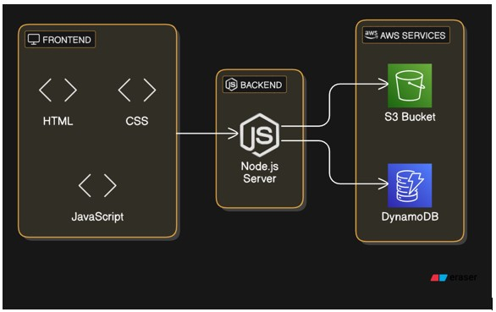
Architecture Diagram
Fig:1 Architectural Diagram

Slide 9
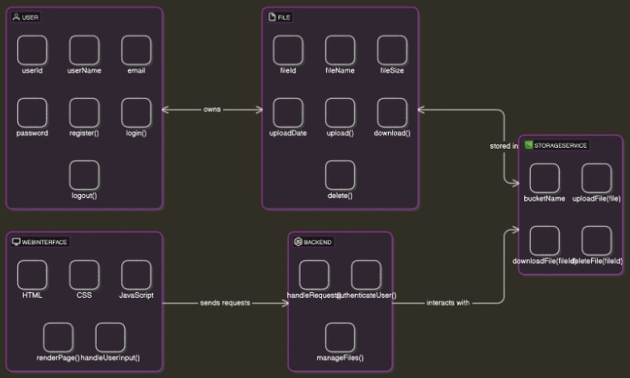
Class Diagram
Fig 2: Class Diagram

Slide 10
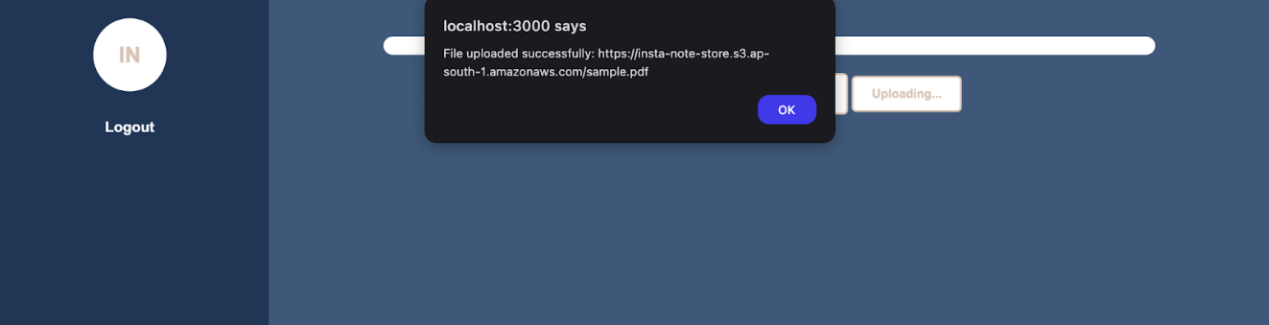
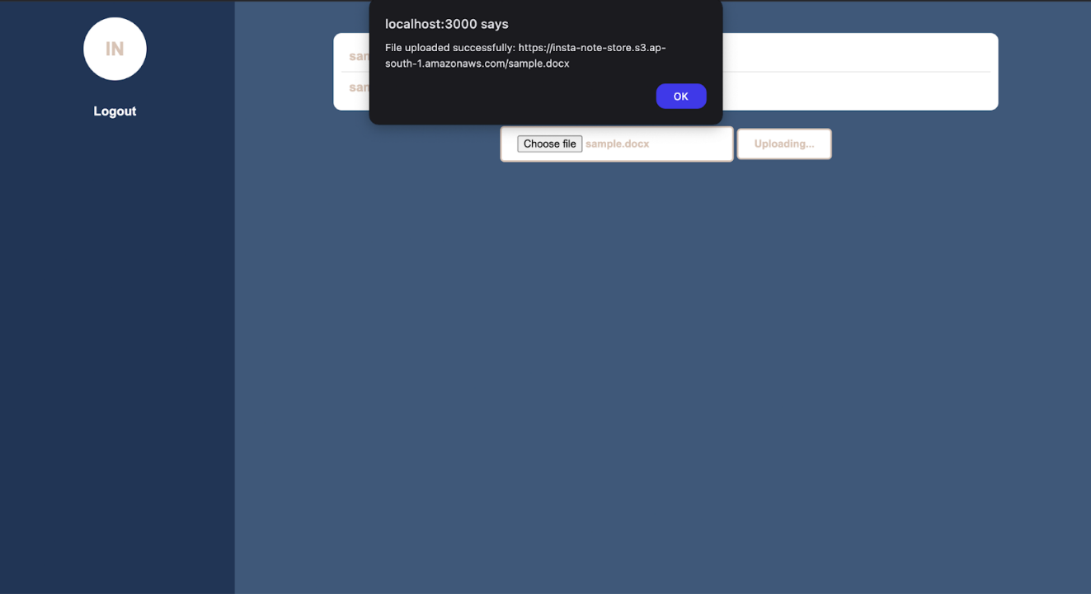
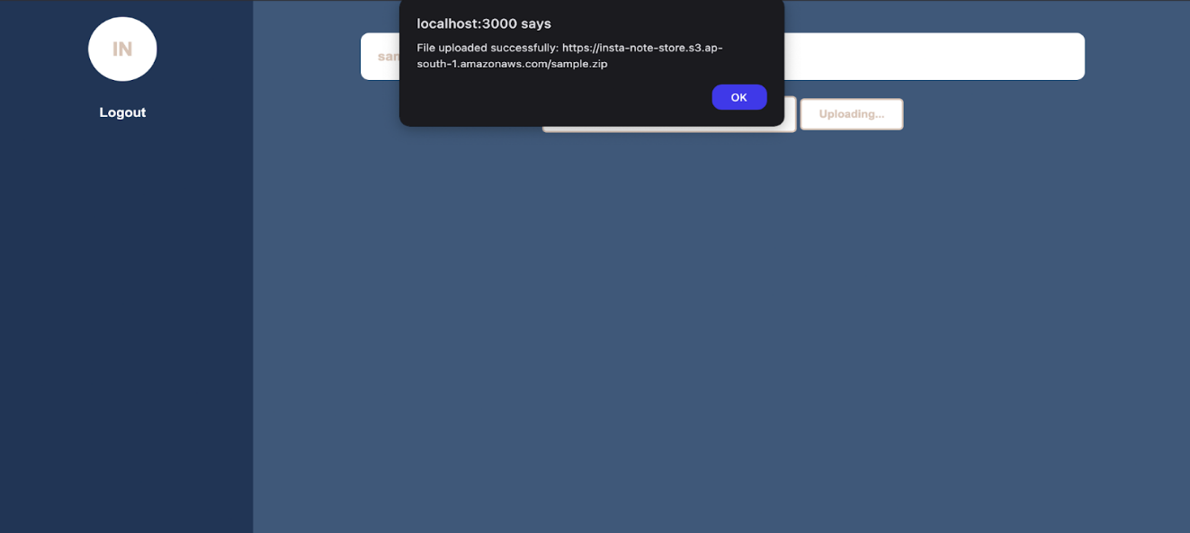
Testing Strategy
Test 1: Uploading a PDF file.
Test 3: Uploading a DOCX file.
Fig 3: First Test Diagram
Result: Successfully uploaded a PDF file.
Test 2: Uploading a ZIP file.
Fig 4: Second Test Diagram
Fig 5: Third Test Diagram
Result: Successfully uploaded a DOCX file.
Result: Successfully uploaded a ZIP file.

Slide 11
Implementation
Setup AWS Environment:
Create an AWS account and configure necessary services, such as Amazon S3 for storage, IAM for user permissions, and EC2 or Lambda for hosting the server-side code.
Front-End Development:
HTML/CSS: Design and develop the user interface with HTML and CSS to ensure a responsive and user-friendly experience.
JavaScript: Implement client-side functionality for interactive features like file selection, drag-and-drop, and progress indicators.
Back-End Development:
Node.js: Develop server-side logic using to handle file uploads, downloads, user authentication, and communication with AWS services.
API Integration: Create RESTful APIs to manage file operations and user requests efficiently.
Amazon S3 Integration:
Configure Amazon S3 buckets to store and retrieve files securely.
Implement secure file upload and download processes using AWS SDKs in the back-end.
Security Implementation:
User Authentication: Implement user authentication and authorization to ensure secure access to the platform.
Access Controls: Configure AWS IAM roles and policies to control access to S3 buckets and other resources.
Encryption: Apply encryption for data at rest (S3) and in transit (HTTPS) to protect user data.

Slide 12
Steps to create S3 bucket in AWS
Step 1: Navigate to the S3 Service
On the AWS Console homepage, use the Search bar at the top and type "S3."
Select S3 from the list of services.
Step 2: Create a Bucket
On the S3 dashboard, click the "Create bucket" button.
Step 3: Configure Bucket Details
Enter a Bucket Name (e.g., instanote-bucket).
The name must be unique across all S3 buckets globally.
Step 4: Set Permissions
Uncheck the "Block all public access" option if you want to allow public access to the bucket. Otherwise, leave it checked.
Review the permission settings.
Step 5: Create the Bucket
Review the settings.
Click the "Create bucket" button.

Slide 13
Creating DynamoDB in AWS
Step 1: Navigate to DynamoDB
On the AWS Console homepage, use the Search bar at the top and type "DynamoDB."
Select DynamoDB from the list of services.
Step 2: Create a DynamoDB Table
On the DynamoDB dashboard, click the "Create table" button.
Step 3: Configure Table Details
Table name: Enter a unique name for your table (e.g. users).
Partition key: Enter a primary key (e.g. email) and select its data type (e.g., String or Number).
3.Optionally, add a Sort key for composite primary keys.
Step 4: Review and Create Table
Review all the table settings.
Click the "Create table" button.

Slide 14
Creating IAM user in AWS
Step 1: Navigate to IAM
On the AWS Console homepage, use the Search bar at the top and type "IAM."
Select IAM from the list of services.
Step 2: Add a New User
On the IAM dashboard, click the "Users" section in the left-hand menu.
Click the "Create user" button.
Step 3: Configure User Details
Enter a Username (e.g., s3-dynamodb-user).
Click “Next”.
Step 4: Review and Create User
Review the user details, permissions, and settings.
Click the "Create user" button.

Slide 15
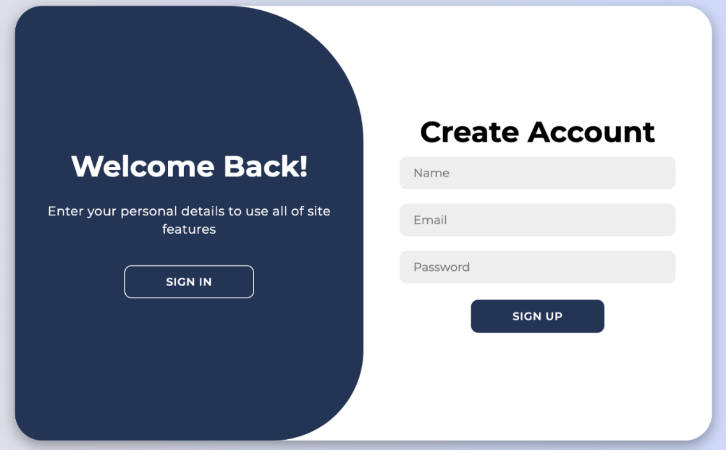
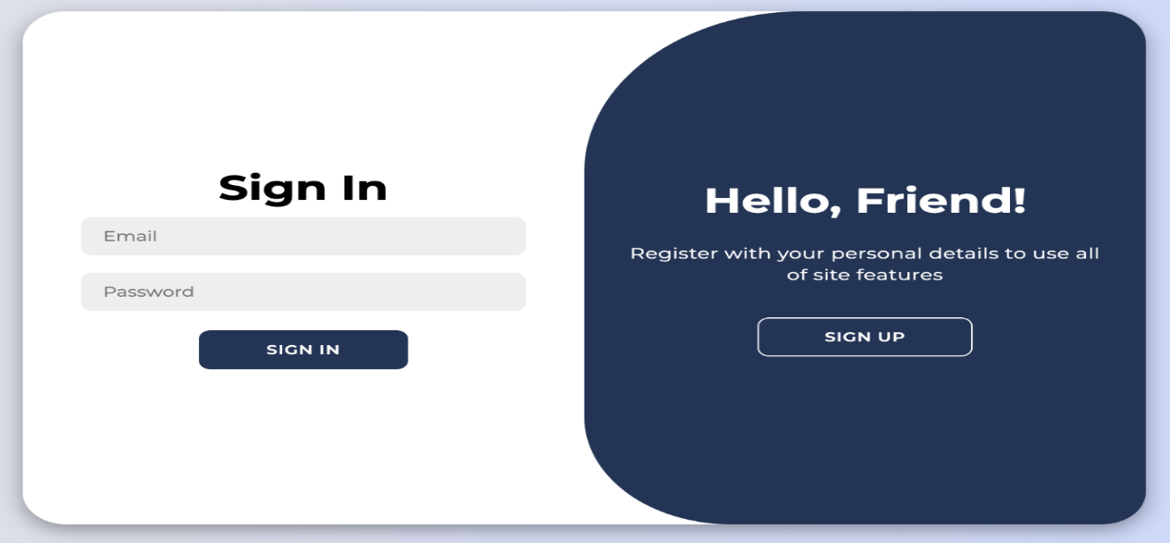
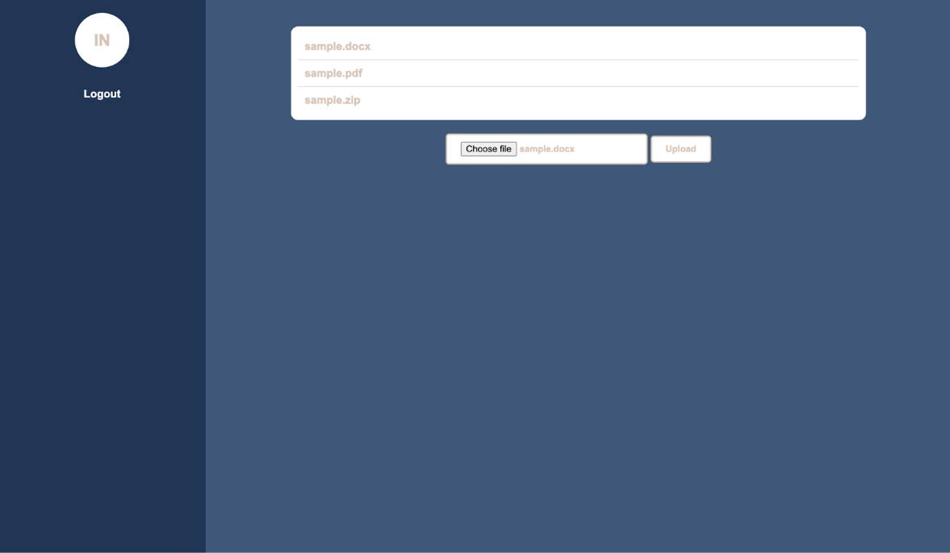
Result
Fig 6: Account Create Interface
Fig 7: User Login Interface
Fig 8: Dashboard Interface

Slide 16
Future Enhancement
Scope for Future Enhancement
Enhanced Security: Implement advanced security measures such as two-factor authentication, encryption of files at rest and in transit, and user activity logging for better monitoring and auditing.
User Roles and Permissions: Develop a role-based access control system to differentiate user permissions, allowing for more granular control over who can upload, download, and manage files.
File Versioning: Introduce a file versioning system to keep track of changes to files and allow users to revert to previous versions if needed.
Collaboration Features: Add features that support collaboration, such as file sharing with specific users, real-time editing, and commenting on files.
Mobile Support: Create a mobile-friendly version of the platform or develop a dedicated mobile app to make it accessible on various devices.
Analytics and Reporting: Provide users with insights and analytics on their file usage, including storage statistics, file access logs, and activity reports.

Slide 17
Thank You

